Slide 1
Gmail automatic reply (out of office)

Slide 2
Gmail automatic reply (out of office)
How to set the Out of Office status in Gmail

Slide 3
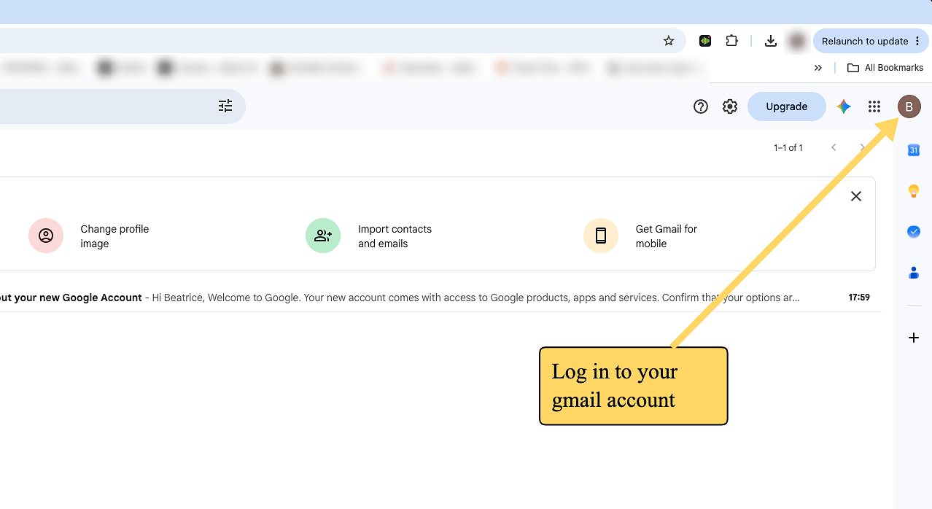
1. Click here

Slide 4
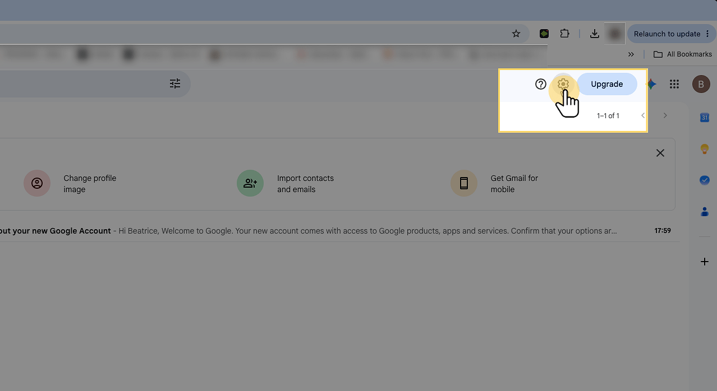
2. Open the Settings menu
Click the gear icon (⚙) in the top-right corner of Gmail to open the quick settings panel.

Slide 5
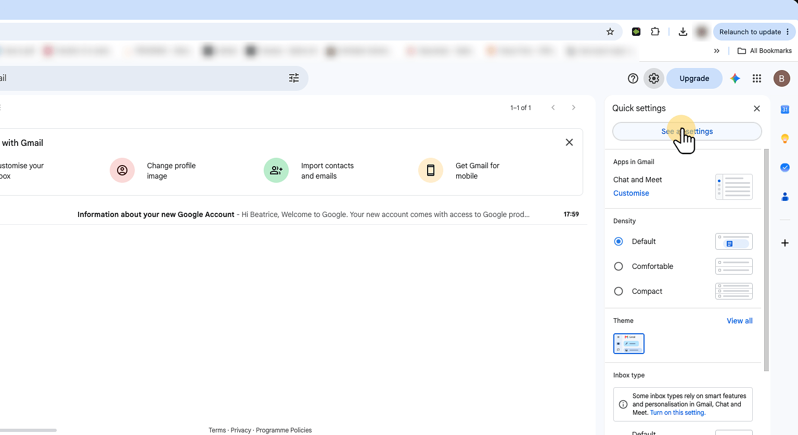
3. Open the full settings page
At the top of the quick settings panel, click See all settings. This opens Gmail's complete settings page, where the vacation responder lives.

Slide 6
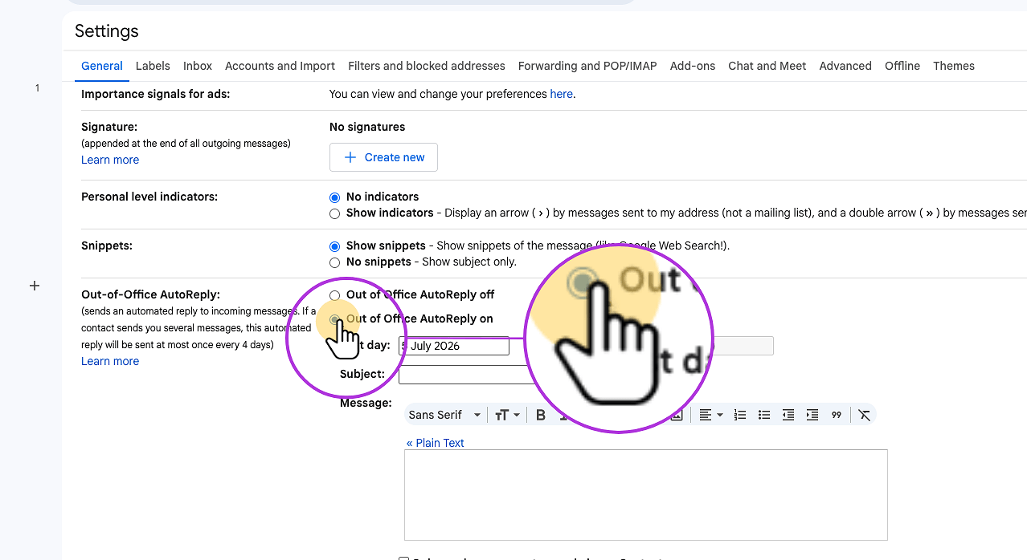
4. Turn the Vacation responder on
Select Vacation responder on (Out of Office AutoReply on). The fields below will activate so you can fill in the details. The First day will fill in automatically. Gmail will start sending auto-replies at midnight on this date.

Slide 7
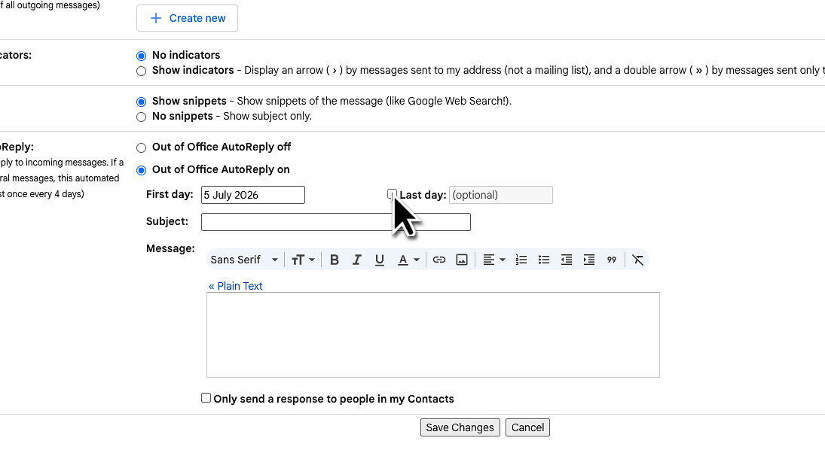
5. Set your last day (optional, but recommended)
Tick the Last day checkbox and choose your return date. Gmail will turn the responder off automatically — no risk of leaving it on after you're back. You may as well leave the field empty, just don't forget to set the Vacation responder to off upon your return.

Slide 8
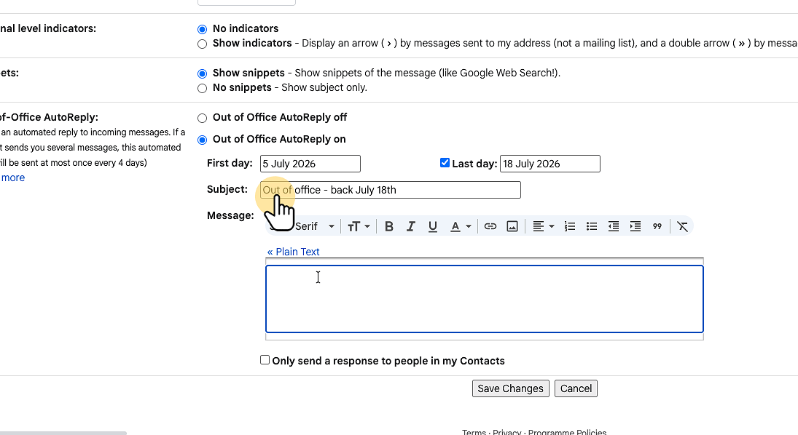
6. Write a clear subject line
Keep it short and direct — something like "Out of office — back [date]". Senders see this in their inbox immediately and know exactly what's going on.

Slide 9
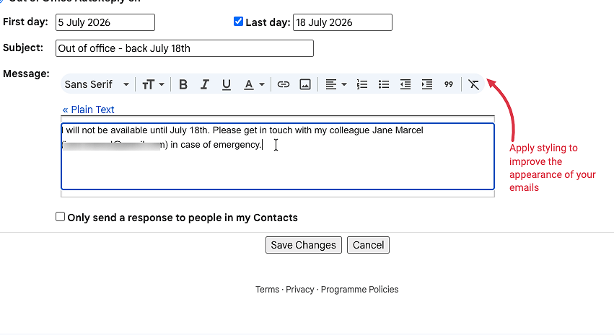
7. Write your auto-reply message
Let people know when you'll be back and who to contact in the meantime. Two or three sentences is plenty. You can use the toolbar to add formatting, links, or your signature.

Slide 10
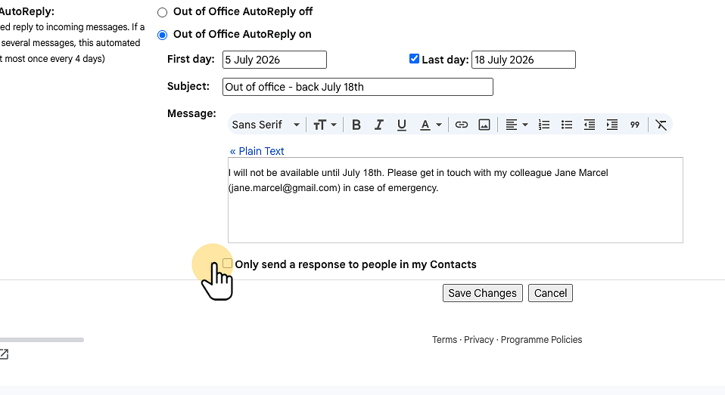
8. Optionally limit who receives the reply
Two checkboxes let you restrict the responder to people in your contacts, or to people inside your company. Use these to keep your auto-reply from going to mailing lists and newsletters.

Slide 11
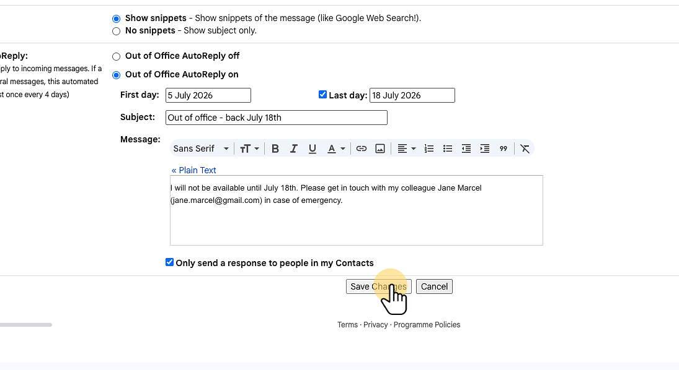
9. Save your changes
Scroll to the bottom of the settings page and click Save Changes. Your Vacation responder is now active and will start on your chosen first day.

Slide 12
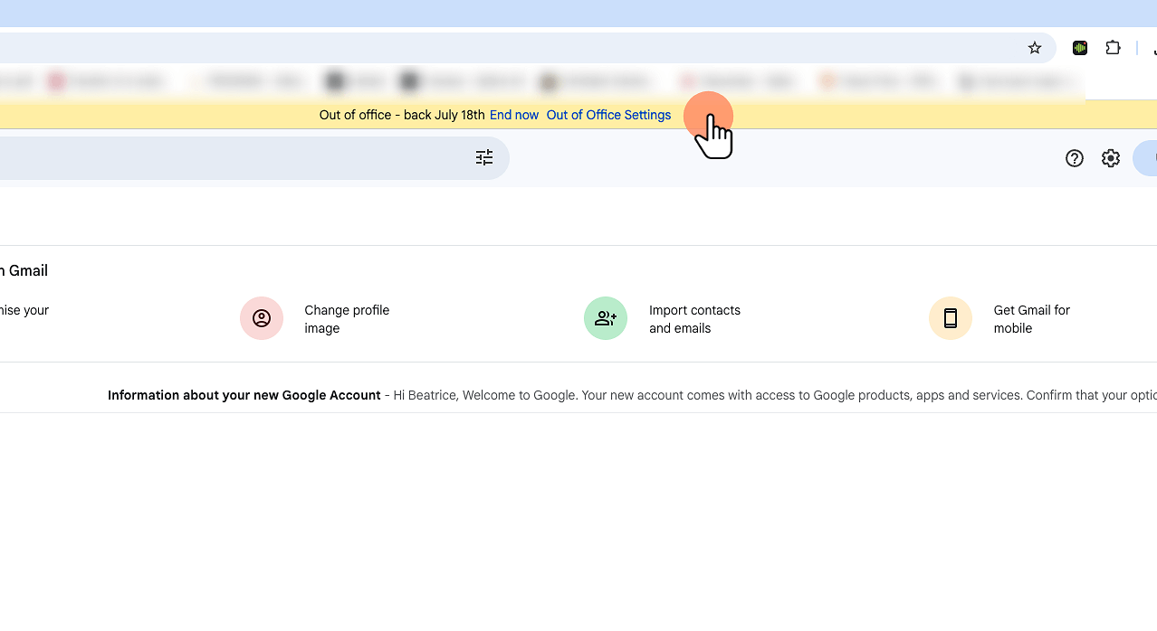
10. You're all set
While the responder is active, Gmail shows a yellow banner at the top of your inbox with an End now button. Click it anytime to turn the auto-reply off before your end date.

